Slide 1
Hotel Industry Analysis
Presented By:
Hrishikesh Telang
Priyal Bamnikar
David Garcia
Liam Hogan
Siddhi Bhandhari

Slide 2
Table of Contents
1
2
3
Project Description
Insights obtained
Recommendations

Slide 3
Project Description
The Hotel Industry, in general, has always been volatile when it comes to reservation and cancellation of rooms. Some customers have reserved hotel rooms months, sometimes even a year before arrival.
However, many of these customers potentially cancel bookings due to unforeseen reasons and other factors.
As data scientists, on behalf of the hotel industry, we aim to understand the historical data and analyze hotel booking trends. These factors can be used to report the trends and predict future bookings.
With the various insights and analyses obtained, we aim to generate insights that can help drive business decisions on how to reduce cancellation bookings and essentially improve profits in the hotel business.

Slide 4
Insights obtained

Slide 5
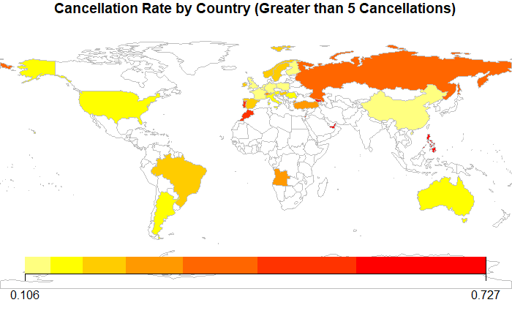
Insight 1

Slide 6
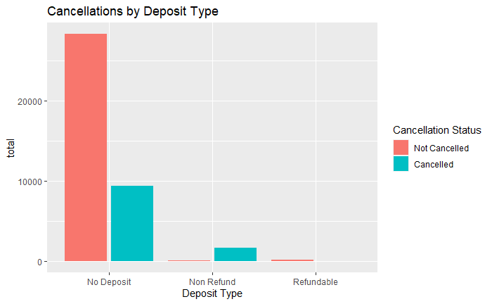
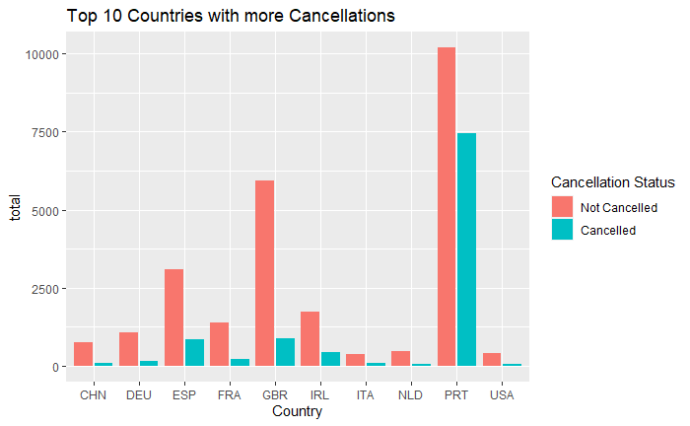
Insight 1

Slide 7
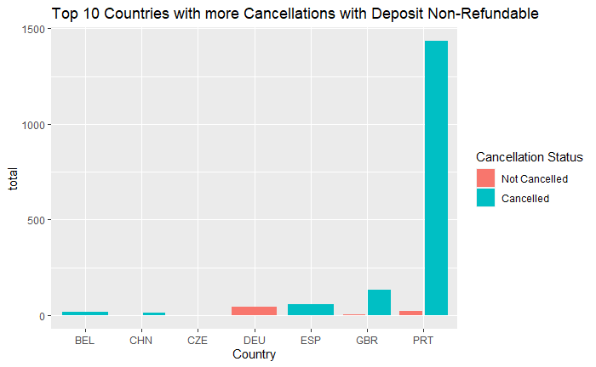
Insight 1

Slide 8
Recommendations
1. All the previous information suggests that we should focus on customers that come from Portugal, have a non-refundable deposit and are considered as transients as they constitute 12.67% of the cancelled population.
2. Since, Room Type A as it is highly linked with cancellations, people of the above subtype who have booked Room Type A could be provided an option to choose another Room Type on a last-minute basis.

Slide 9
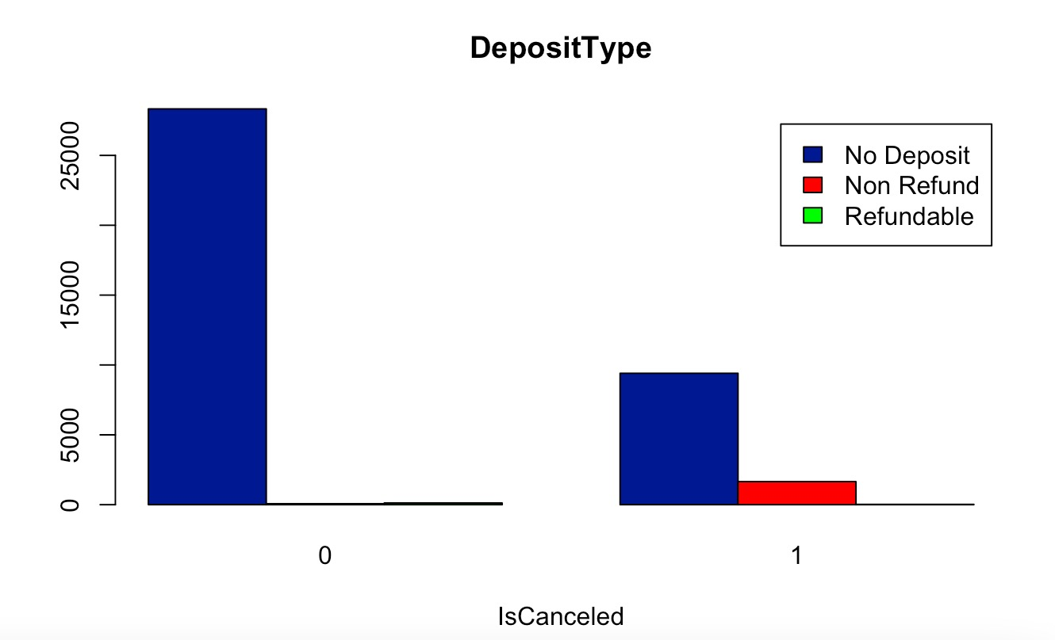
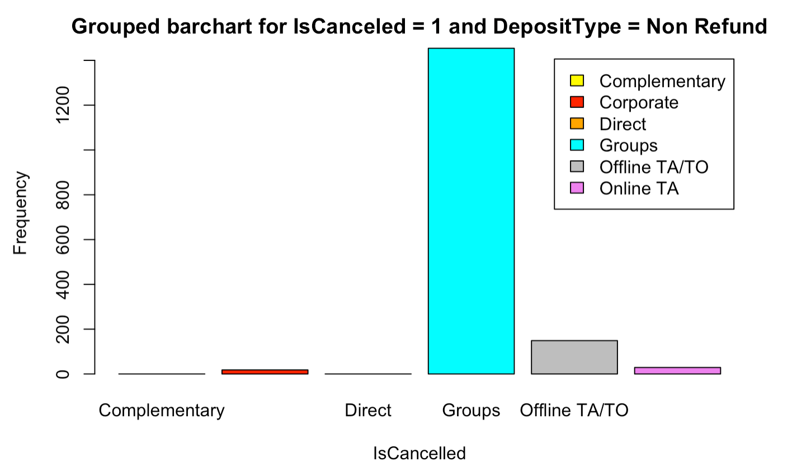
Insight 2
Market Segment
Cancellations on the basis of the Deposit Type

Slide 10
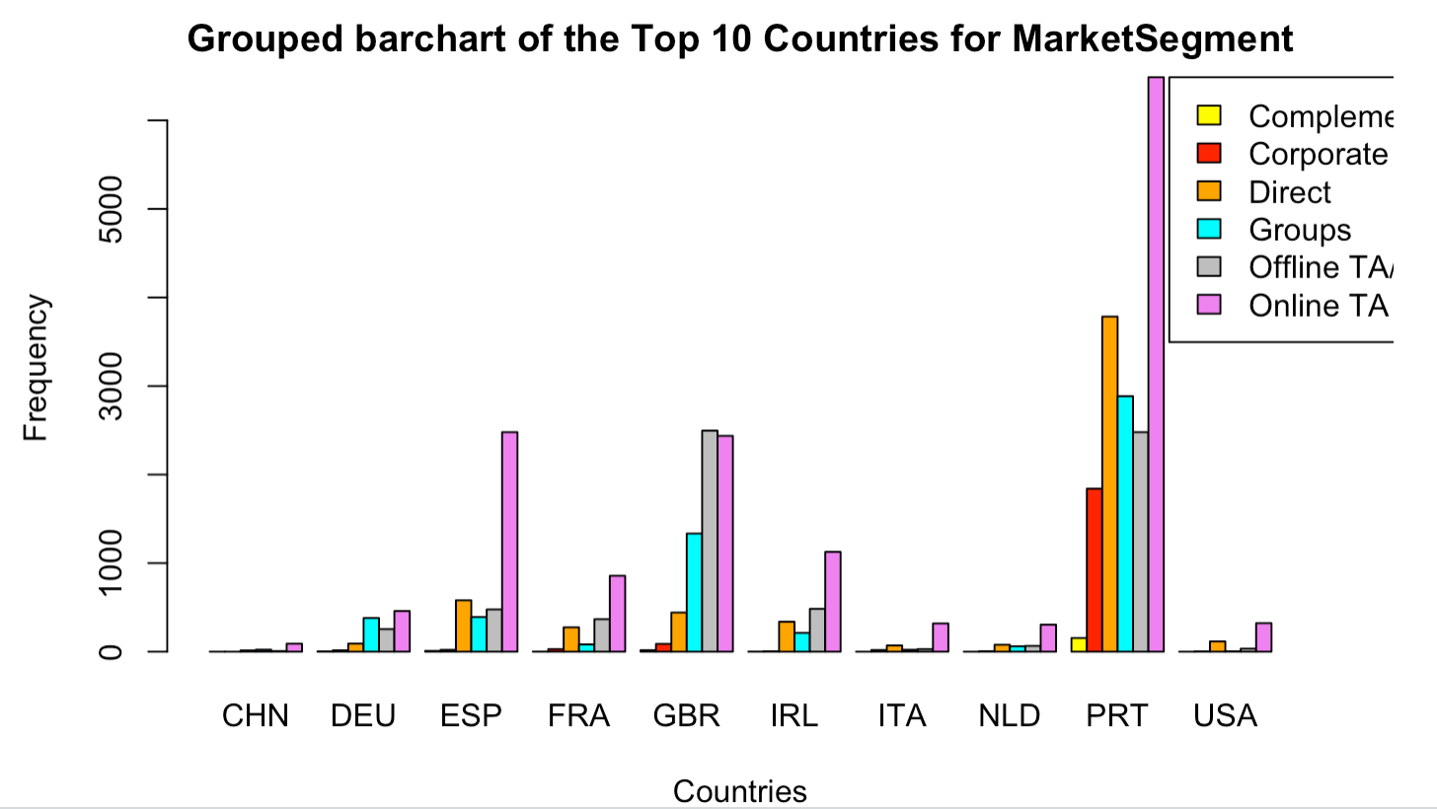
Insight 2

Slide 11
Recommendation
Encourage customers of group type bookings to opt for deposit type bookings with special discount offers, provide gift vouchere or introduce a points-based system to avail discounts for future travel plans.

Slide 12
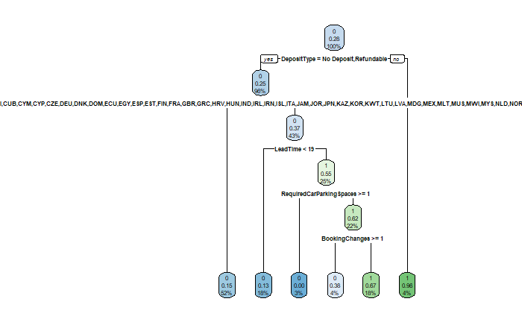
Insight 3

Slide 13
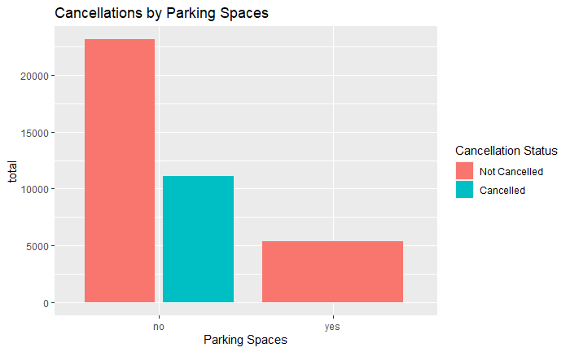
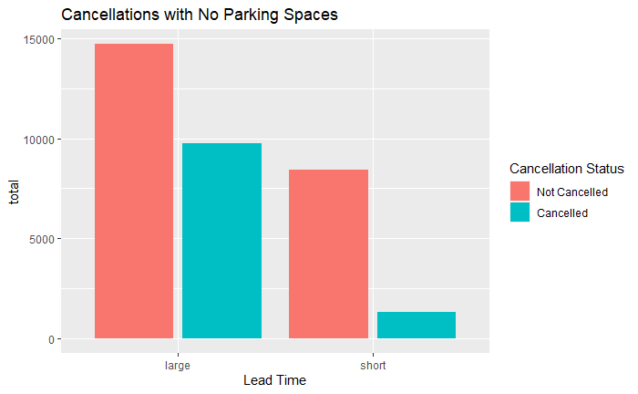
Insight 3

Slide 14
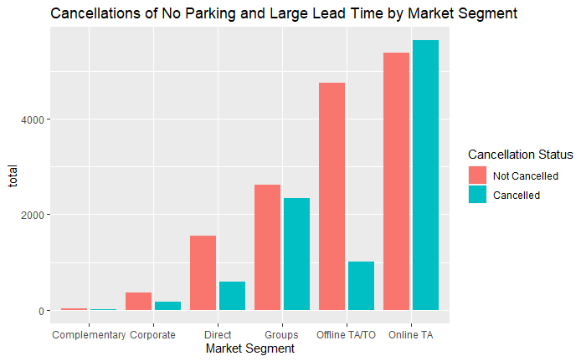
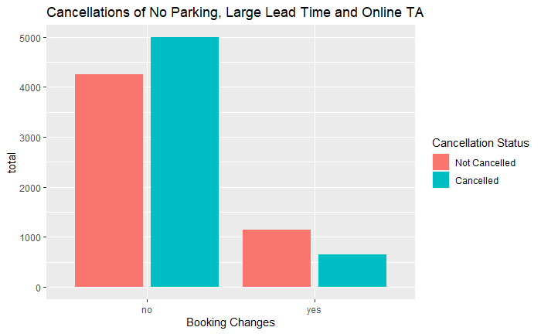
Insight 3

Slide 15
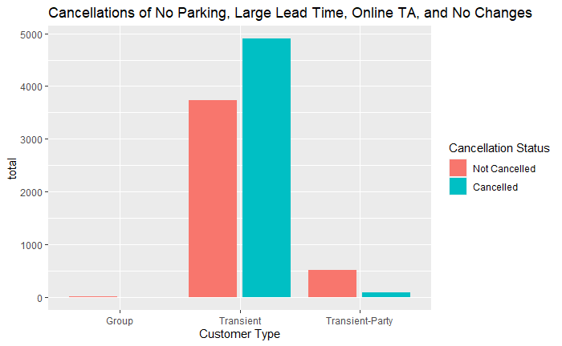
Insight 3

Slide 16
Recommendation
1. All the previous information suggests that we should focus on customers that don’t need parking spaces, reserve from countries with large lead time, belong to the ‘Online TA’ market segment, and don’t have booking changes as they constitute 44.23% of the cancelled population.
2. Since, Room Type H and Meal Plan BB as it is highly linked with cancellations, people of the above subtype who have booked Room Type H or Meal Plan BB could be provided an option to choose another Room Type or Meal Plan on a last-minute basis.

Slide 17
Summary of Recommendations
1. All the previous information suggests that we should focus on customers that come from Portugal, have a non-refundable deposit and are considered as transients as they constitute 12.67% of the cancelled population.
2. Since, Room Type A as it is highly linked with cancellations, people of the above subtype who have booked Room Type A could be provided an option to choose another Room Type on a last-minute basis.
3. Encourage customers of group type bookings to opt for deposit type bookings with special discount offers, provide gift vouchere or introduce a points-based system to avail discounts for future travel plans.
4. All the previous information suggests that we should focus on customers that don’t need parking spaces, reserve from countries with large lead time, belong to the ‘Online TA’ market segment, and don’t have booking changes as they constitute 44.23% of the cancelled population.
5. Since, Room Type H and Meal Plan BB as it is highly linked with cancellations, people of the above subtype who have booked Room Type H or Meal Plan BB could be provided an option to choose another Room Type or Meal Plan on a last-minute basis.

Slide 18
Thanks!
Do you have any questions?

